Slide 1
Robotics
Session 5:
Using Processing
For prototyping

Slide 2
Aims:
To create a visual prototype of your robot.

Slide 3
Where to get it...
download from https://processing.org/download/?processing
So, STEP 1 is to download (you may have already done this step), unzip, and follow the code examples in these slides.

Slide 4
Get started
Open Processing and we will create a new sketch.
Name it something meaningful.
Lets draw a simple rectangle.
There are two basic functions that need to be in a sketch. Setup() is called once on startup and draw() runs until you close the sketch window. In the setup function we need to define the size of the sketch in pixels. For this tutorial we will stick with 1200x800.
Now we already have a working sketch. Next we insert a rectangle by using rect(). The four parameters for this function are x-position, y-position, x-size and y-size. There are other shapes like ellipses that follow the same scheme.
Add the code on the next slide to your sketch and then click run.

Slide 5
Rectangle Code
void setup(){
size(1200, 800);
}
void draw(){
fill(#FF9F03);
noStroke();
rect(100, 100, 500, 500);
}

Slide 6
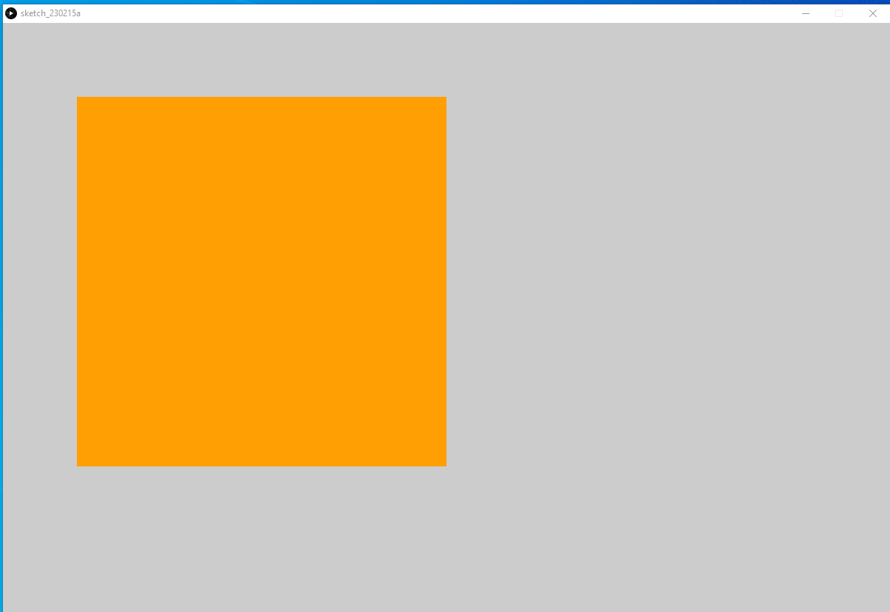
Rectangle Output
You should see something like this

Slide 7
Cube time
Now either start a new sketch or reuse the one you have.
Lets draw a simple cube.
Turning the square into a box requires a few changes. We need to change to a 3D renderer by adding OPENGL to the size function. Box(size) creates an equal sided cube at the origin (top left corner). The function translate(x, y, z) can be used to move it away from the corner.
Rotation is done using rotateX(angle), rotateY(angle) and rotateZ(angle).
Width and height are referencing the values we added to the size function, translate(width/2, height/2) always makes the cube appear at the centre.
To enable anti aliasing we need to call the smooth() function. This will not work without adding background(colour), that gets called every cycle to overwrite the screen. Lights() turns the lights on and add shades to the cube.
Add the code on the next slide to your sketch and then click run.

Slide 8
Cube Code
void setup(){
size(1200, 800, OPENGL);
}
void draw(){
background(32);
smooth();
lights();
fill(#FF9F03);
noStroke();
translate(width/2, height/2);
rotateX(-0.5);
rotateY(0.5);
box(300);
}

Slide 9
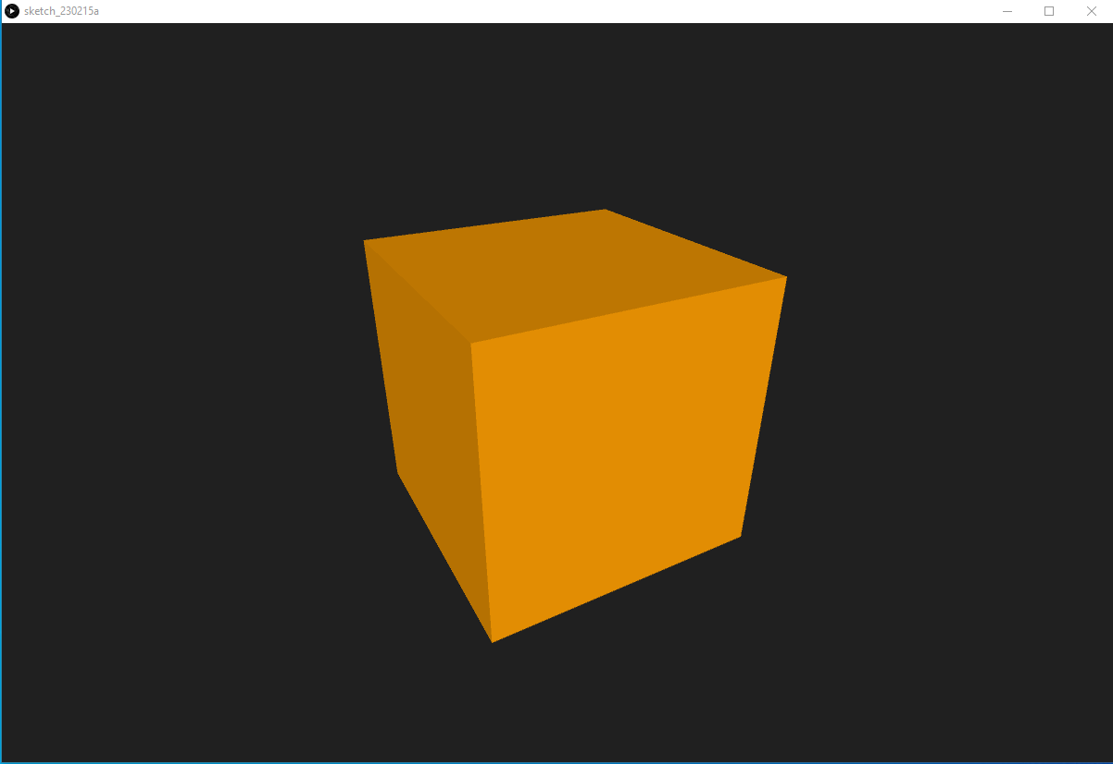
Cube Output
You should see something like this

Slide 10
Mouse Controls
Now either start a new sketch or reuse the one you have.
Lets spice things up by moving our cube.
The easiest way to do this is replacing the fixed rotation values with the mouse position to rotate the cube around while the sketch is running.
We need to create two variables, rotX and rotY that well be used as view rotation. T
he function mouseDragged() is used to write the mouse position to these variables while a mouse button is pressed.
Add the code on the next slide to your sketch and then click run.

Slide 11
Mouse Controls Code
float rotX, rotY;
void setup(){
size(1200, 800, OPENGL);
}
void draw(){
background(32);
smooth();
lights();
fill(#FF9F03);
noStroke();
translate(width/2, height/2);
rotateX(rotX);
rotateY(-rotY);
box(300);
}
void mouseDragged(){
rotY -= (mouseX - pmouseX) * 0.01;
rotX -= (mouseY - pmouseY) * 0.01;
}

Slide 12
Mouse Controls Output
Your cube should be able to be moved by your mouse.

Slide 13
Importing Geometry
Now either start a new sketch or reuse the one you have.
Not many robots re cube shaped besides a GONK droid or WALL-E, so we need to import some relevant 3d shapes in the form of .OBJ files.
For the next steps you will have to download the parts in the learning materials alongside these slides.
Create a new folder in the direction of your sketch file and name it "data". Unpack the 5 obj-files to that folder.
We can now import these objects to our sketch by creating a PShape for each of them and using loadShape("file") to assign the obj-file.
Replace the box with shape(base) and Processing will draw the geometry.
Depending on the units we will have to scale(factor) the object to better fit the screen.
Add the code on the next 2 slides to your sketch and then click run.

Slide 14
Importing Geometry Code 1
PShape base, shoulder, upArm, loArm, end;
float rotX, rotY;
void setup(){
size(1200, 800, OPENGL);
base = loadShape("r5.obj");
shoulder = loadShape("r1.obj");
upArm = loadShape("r2.obj");
loArm = loadShape("r3.obj");
end = loadShape("r4.obj");
}

Slide 15
Importing Geometry Code 2
void draw(){
background(32);
smooth();
lights();
noStroke();
translate(width/2,height/2);
scale(-4);
translate(0,-40,0);
rotateX(rotX);
rotateY(-rotY);
shape(base);
}
void mouseDragged(){
rotY -= (mouseX - pmouseX) * 0.01;
rotX -= (mouseY - pmouseY) * 0.01;
}

Slide 16
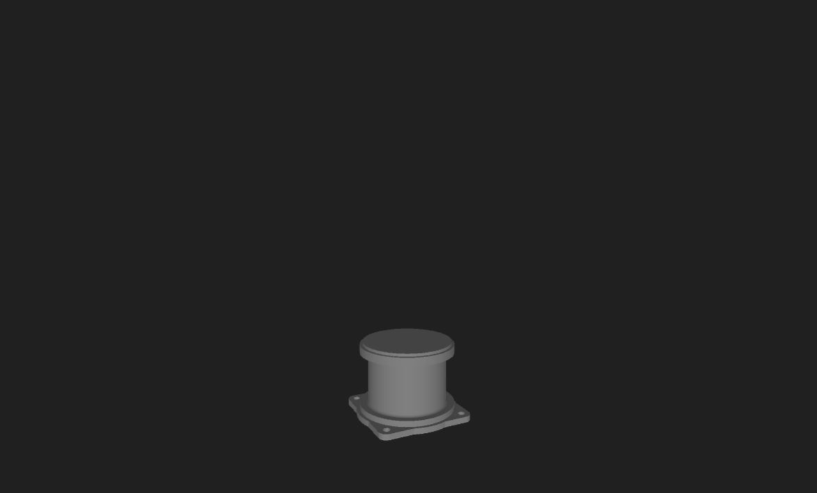
Importing Geometry Output
You should see something like this.

Slide 17
Joining things together
Now either start a new sketch or reuse the one you have.
Now to assemble the parts we have imported.
Use the translate/rotate functions to position the parts. Translation and rotation values will always add up. That means that all parts are in a chain where each link is moved relatively to its predecessor.
If you are using your own robot parts you can find the right translation values in the cad file. If the base is 60mm high you have to translate the next part 60 units and so on. Rotation values are in radians and sometimes it will take a few attempts to find the right ones.
By defining three rotation values as variables we will be able to move the joints in the next step.
If you export your obj-files from a CAD software there will be a second mtl-file containing the color settings and Processing will render it that way.
If not, disableStyle() can be used to render objects with the standard fill/stroke setting.
Add the code on the next 2 slides to your sketch and then click run.

Slide 18
Joining things together Code 1
PShape base, shoulder, upArm, loArm, end;
float rotX, rotY;
float alpha = -1, beta = -2, gamma;
void setup(){
size(1200, 800, OPENGL);
base = loadShape("r5.obj");
shoulder = loadShape("r1.obj");
upArm = loadShape("r2.obj");
loArm = loadShape("r3.obj");
end = loadShape("r4.obj");
shoulder.disableStyle();
upArm.disableStyle();
loArm.disableStyle();
}

Slide 19
Joining things together Code 2
void draw(){
background(32);
smooth();
lights();
fill(#FFE308);
noStroke();
translate(width/2,height/2);
scale(-4);
translate(0,-40,0);
rotateX(rotX);
rotateY(-rotY);
shape(base);
translate(0, 4, 0);
rotateY(gamma);
shape(shoulder);
translate(0, 25, 0);
rotateY(PI);
rotateX(alpha);
shape(upArm);
translate(0, 0, 50);
rotateY(PI);
rotateX(beta);
shape(loArm);
translate(0, 0, -50);
rotateY(PI);
shape(end);
}
void mouseDragged(){
rotY -= (mouseX - pmouseX) * 0.01;
rotX -= (mouseY - pmouseY) * 0.01;
}

Slide 20
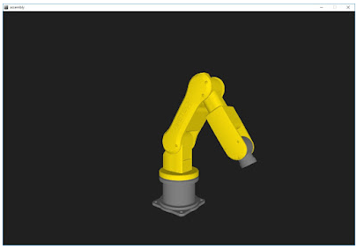
Joining things together Output
You should see something like this.

Slide 21
Moving the robot.
Now either start a new sketch or reuse the one you have.
This next step requires an additional tab to be present, so add one.
The IK() function converts three coordinates to three angles.
SetTime() generates a time value from 0 to 4.
WritePos() calls both functions and generates a sine function that looks like a horizontal eight, making for smooth movements of the robot.
If you look at the code in the second tab, it could easily be run on an arduino without alterations.
Add the code on the next 3 slides to your sketch and then click run.

Slide 22
Main Tab Code 1
PShape base, shoulder, upArm, loArm, end;
float rotX, rotY;
float posX=1, posY=50, posZ=50;
float alpha, beta, gamma;
void setup(){
size(1200, 800, OPENGL);
base = loadShape("r5.obj");
shoulder = loadShape("r1.obj");
upArm = loadShape("r2.obj");
loArm = loadShape("r3.obj");
end = loadShape("r4.obj");
shoulder.disableStyle();
upArm.disableStyle();
loArm.disableStyle();
}
void draw(){
writePos();
background(32);
smooth();
lights();
fill(#FFE308);
noStroke();
translate(width/2,height/2);
rotateX(rotX);
rotateY(-rotY);
scale(-4);
translate(0,-40,0);
shape(base);
translate(0, 4, 0);
rotateY(gamma);
shape(shoulder);

Slide 23
Main Tab Code 2
translate(0, 25, 0);
rotateY(PI);
rotateX(alpha);
shape(upArm);
translate(0, 0, 50);
rotateY(PI);
rotateX(beta);
shape(loArm);
translate(0, 0, -50);
rotateY(PI);
shape(end);
}
void mouseDragged(){
rotY -= (mouseX - pmouseX) * 0.01;
rotX -= (mouseY - pmouseY) * 0.01;
}

Slide 24
Inverse Tab Code 1
float F = 50;
float T = 70;
float millisOld, gTime, gSpeed = 4;
void IK(){
float X = posX;
float Y = posY;
float Z = posZ;
float L = sqrt(Y*Y+X*X);
float dia = sqrt(Z*Z+L*L);
alpha = PI/2-(atan2(L, Z)+acos((T*T-F*F-dia*dia)/(-2*F*dia)));
beta = -PI+acos((dia*dia-T*T-F*F)/(-2*F*T));
gamma = atan2(Y, X);
}
void setTime(){
gTime += ((float)millis()/1000 - millisOld)*(gSpeed/4);
if(gTime >= 4) gTime = 0;
millisOld = (float)millis()/1000;
}
void writePos(){
IK();
setTime();
posX = sin(gTime*PI/2)*20;
posZ = sin(gTime*PI)*10;
}

Slide 25
Final touches
Now either start a new sketch or reuse the one you have.
With the code above you now have a fully functional robotics simulator.
But there are many other things to do with processing.
For the last step an effect was added that was supposed to look like a spray can.
If you want you can export the entire project to a executable program for windows or any other operating system by clicking on "Export Application".
Add the code on the next 2 slides to your sketch and then click run.

Slide 26
Final Touches Code 1
PShape base, shoulder, upArm, loArm, end;
float rotX, rotY;
float posX=1, posY=50, posZ=50;
float alpha, beta, gamma;
float[] Xsphere = new float[99];
float[] Ysphere = new float[99];
float[] Zsphere = new float[99];
void setup(){
size(1200, 800, OPENGL);
base = loadShape("r5.obj");
shoulder = loadShape("r1.obj");
upArm = loadShape("r2.obj");
loArm = loadShape("r3.obj");
end = loadShape("r4.obj");
shoulder.disableStyle();
upArm.disableStyle();
loArm.disableStyle();
}
void draw(){
writePos();
background(32);
smooth();
lights();
directionalLight(51, 102, 126, -1, 0, 0);
for (int i=0; i< Xsphere.length - 1; i++) {
Xsphere[i] = Xsphere[i + 1];
Ysphere[i] = Ysphere[i + 1];
Zsphere[i] = Zsphere[i + 1];
}
Xsphere[Xsphere.length - 1] = posX;
Ysphere[Ysphere.length - 1] = posY;
Zsphere[Zsphere.length - 1] = posZ;
noStroke();

Slide 27
Final Touches Code 2
noStroke();
translate(width/2,height/2);
rotateX(rotX);
rotateY(-rotY);
scale(-4);
for (int i=0; i < Xsphere.length; i++) {
pushMatrix();
translate(-Ysphere[i], -Zsphere[i]-11, -Xsphere[i]);
fill (#D003FF, 25);
sphere (float(i) / 20);
popMatrix();
}
fill(#FFE308);
translate(0,-40,0);
shape(base);
translate(0, 4, 0);
rotateY(gamma);
shape(shoulder);
translate(0, 25, 0);
rotateY(PI);
rotateX(alpha);
shape(upArm);
translate(0, 0, 50);
rotateY(PI);
rotateX(beta);
shape(loArm);
translate(0, 0, -50);
rotateY(PI);
shape(end);
}
void mouseDragged(){
rotY -= (mouseX - pmouseX) * 0.01;
rotX -= (mouseY - pmouseY) * 0.01;
}

Slide 28
Useful resources
https://processing.org/reference/
https://forum.processing.org/two/
https://www.tinkercad.com/dashboard

Slide 29
processing and prototyping
Processing is excellent for creating GUIs and visual representations of our robots.
This means we can ‘visualise’ what our robots will do.

